Slide 1
Capital Asset Pricing Model (CAPM)

Slide 2
The Capital Asset Pricing Model (CAPM) is a Model that describes the relationship between the expected return and risk of investing in a security. It shows that the expected return on a security is equal to the risk-free return plus a risk premium, which is based on the beta of that security.
The capital asset pricing model was developed by the financial economist (and later, Nobel laureate in economics ) William Sharpe, set out in his 1970 book Portfolio Theory and Capital Markets. His model starts with the idea that individual investment contains two types of risk: systematic and Unsystamatic Risk
CAPM is calculated according to the following formula
Ra=Rrf+Ba(Rm-Rrf)
Where
Ra = Expected return on a security
Rrf = Risk-free rate
Ba = Beta of the security

Slide 3
Expected return = Risk free rate+ (Beta x Market risk premium)
Rm = Expected return of the market
Note: “Risk Premium” = (Rm – Rrf)
The CAPM formula is used for calculating the expected returns of an asset. It is based on the idea of systematic risk (otherwise known as non-diversifiable risk) that investors need to be compensated for in the form of a risk premium. A risk premium is a rate of return greater than the risk-free rate. When investing, investors desire a higher risk premium when taking on more risky investment

Slide 4
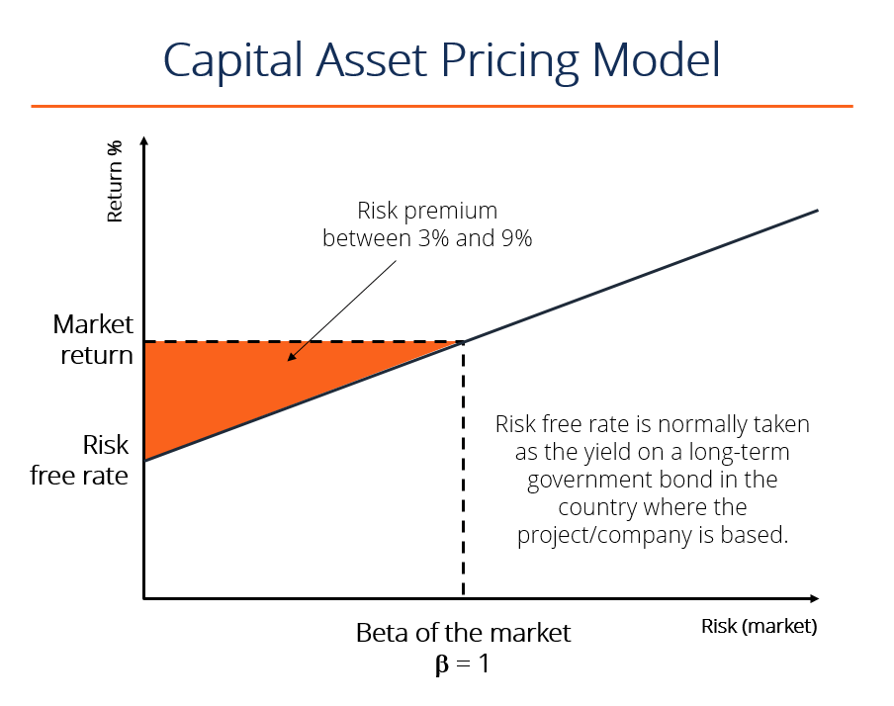

Slide 5
Let’s calculate the expected return on a stock, using the Capital Asset Pricing Model (CAPM)formula. Suppose the following information about a stock is known:
It trades on the NYSE and its operations are based in the United States Current yield on a U.S. 10-year treasury is 2.5%
The average excess historical annual return for U.S. stocks is 7.5%
The beta of the stock is 1.25 (meaning its average return is 1.25x as volatile as the S&P500 over the last 2 years
What is the expected return of the security using the CAPM formula?
Let’s break down the answer using the formula from above in the article:
Expected return = Risk Free Rate + [Beta x Market Return Premium]
Expected return = 2.5% + [1.25 x 7.5%]
Expected return = 11.9%

Slide 6
For example 2, imagine an investor is contemplating a stock worth $100 per share today that pays a 3% annual dividend. The stock has a beta compared to the market of 1.3, which means it is riskier than a market portfolio. Also, assume that the risk-free rate is 3% and this investor expects the market to rise in value by 8% per year.
The expected return of the stock based on the CAPM formula is
ERi= 3%+1.3 × (8%−3) =9.5%

Slide 7
Example 3-The beta of McGrow Co. is 1.2. The risk-free rate is 3.5 percent and the expected return on the market is 8 percent. What is the stock’s required return?
Solution
E(R) = k=Rf+ beta * (Rm-Rf)
=3.5%+1.2 * (8%-3.5%) =8.9%

Slide 8
Advantages of the CAPM
The CAPM has several advantages over other methods of calculating required return, explaining why it has been popular for more than 40 years:
It considers only systematic risk, reflecting a reality in which most investors have diversified portfolios from which unsystematic risk has been essentially eliminated. It is a theoretically-derived relationship between required return and systematic risk which has been subject to frequent empirical research and testing.
It is generally seen as a much better method of calculating the cost of equity than the dividend growth model (DGM) in that it explicitly considers a company’s level ofsystematic risk relative to the stock market as a whole.
It is clearly superior to the WACC in providing discount rates for use in investment appraisal

Slide 9
Disadvantages of the CAPM
-To use the CAPM, values need to be assigned to the risk-free rate of return, the return on the market, or the equity risk premium (ERP), and the equity beta.
-The yield on short-term government debt, which is used as a substitute for the risk-free rate of return, is not fixed but changes regularly with changing economic circumstances. A short-term average value can be used to smooth out this volatility.
- Finding a value for the equity risk premium (ERP) is more difficult.
- Beta values are now calculated and published regularly for all stock exchange-listed companies. The problem here is that uncertainty arises in the value of the expected return because the value of beta is not constant, but changes over time

